Slide 1

AI-Powered Patient Flow Optimisation: Solving the NHS Bed Crisis
A Smart Bed Management Ecosystem for 2026
Presented By

Slide 2
Industry Overview
The NHS has 1.5 million staff and a £190 billion budget (The King's Fund, 2025).
The organisation has 7.6 million patients on waiting lists now.
The organisation has strong trusts that give priority to AI for efficiency at 67% (NHS England, 2026).
The main opportunity is in the government’s £10 billion digital pledge.
Notes:
The NHS is the biggest employer in the UK, with 1.5 million staff and an annual budget of £190 billion and there are 7.6 million patients on waiting lists by 2026. About 67% of NHS Trusts see AI as a tool for operational efficiency, but digital maturity is behind other sectors. The government’s £10 billion digital transformation pledge is a golden opportunity for AI-powered solutions in healthcare.

Slide 3

Business Problem Definition
The Exit Block traps patients amid social care delays.
About 25% of total beds in hospitals are blocked (Charlesworth, Rachet-Jacquet and Rocks, 2024).
The costs for the NHS are £2.3bn every year (NHS England, 2025).
There is critical staff burnout, as the 4-hour A&E target is regularly not met.
Notes:
Exit Block is when patients who are fit to leave the hospital cannot do so due to delays in social care. One in four hospital beds are caught in this cycle which causes queues of ambulances outside A&E and daily cancellations of elective surgery. The crisis costs the NHS £2.3 billion every year and the vast majority of Trusts regularly fail to hit the government’s 4-hour A&E target and staff burnout is at crisis point.

Slide 4

AI Solution Overview
Four AI tools are integrated into the current NHS systems.
There are four tools that are powered by patient data from the EHR.
A Single dashboard puts clinicians in control and improves existing systems, making them feasible and ready for immediate implementation (Bischof et al., 2024).
Notes:
The Smart Bed Management Ecosystem links 4 AI tools with existing NHS systems and the patient data is fed from EHR into each tool. They all feed into one unified dashboard which provides clinicians with complete visibility and control. This solution does not require an individual to rip and replace existing systems and it adds to what the NHS has, making it practical along with cost-effective and ready to go straight away.

Slide 5

Portfolio Showcase
Predictive Discharge AI forecasted that there are discharge dates about 48 hours early (Hsu et al., 2022).
There are NLP document scanners that scan clinical notes and flags are complex cases.
The smart bed allocation assigns incoming patients to appropriate wards (Maddeh et al., 2023).
There is computer vision monitors where waiting room density is real-time.
Notes:
Tool one is Predictive Discharge AI which predicts discharge dates 48 hours in advance and Tool two is the NLP Document Scanner, which scans clinical notes and flags complex cases in real time. Tool three is Smart Bed Allocation and it assigns the incoming patients to appropriate wards. After that, Tool Four is computer vision which observes density in the waiting room. All four of these tools are combined into a single dashboard to provide clinicians full visibility and real-time control over patient flow.

Slide 6

Ethics and Governance
Federated Learning means that there would be no patient data that would ever leave NHS servers (Soltan et al., 2024).
Algorithmic bias is addressed and fairness ensured through regular audits.
Explainable AI gives clinicians a way to know the reason behind each prediction (Rane, Choudhary and Rane, 2023).
Notes:
There are ethical risks like data privacy, algorithmic bias and transparency and federated learning means patient data never leaves NHS servers. Fairness is audited routinely to address bias and explainable AI makes it possible for clinicians to understand each prediction. Human-in-the-Loop means the doctors have the last word and it is fully compliant with the UK GDPR, NHS DSPT, CQC and MHRA regulations and every design decision is driven by patient safety.

Slide 7
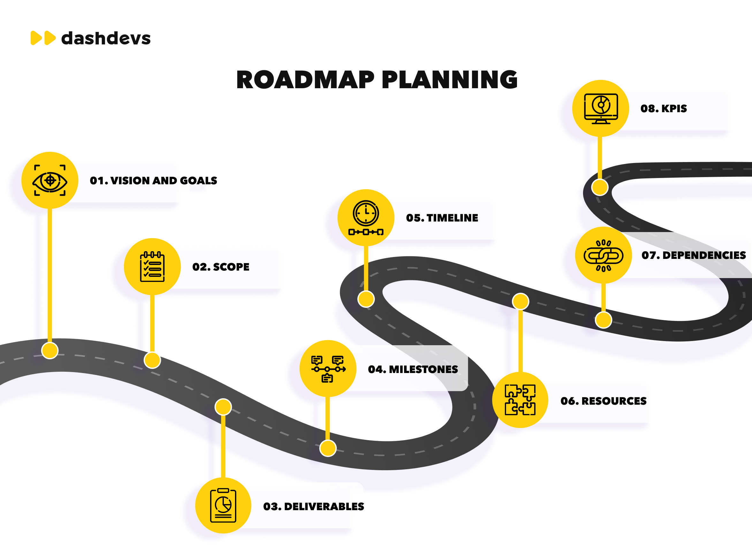
Implementation Roadmap
The first steps are data integration and staff training.
There could be a pilot on selected wards and then roll out across the trust.
Build partnerships with the NHS and gain funding and leadership buy-in (Barat et al., 2026).
Notes:
Implementation will start with quick wins with data integration, staff training and dashboard deployment in two pilot wards within three months. Phase two will be expanded to five wards and Phase three will complete the Trust-wide roll-out. The solution will expand across the country by 2029 and the next steps are obtaining Chief Clinical Information Officer buy-in which creates an NHS Trust partnership and funding approval for the pilot.

Slide 8

Conclusion
The NHS cannot wait, as this solution delivers faster care and more surgeries.
AI-driven patient flow is essential and not a luxury for 2026.
It is important to act now because it is very important in the current times.
Notes:
The NHS cannot wait and this solution means quicker A&E and more elective surgery, with less staff burnout and savings of £150m per year per Trust. AI-driven patient flow is not a luxury and it is an essential for the NHS in 2026. The piloting phase is behind us and now is the time to act and thanks for your time and attention.

Slide 9
References
Barat, A., Scarbrough, H., Schulte, J., McKenzie, F., Patel, H. and Stavropoulou, C., 2026. Using a peer-led network to overcome the barriers to innovation in the NHS: the case of the NHS InSites Programme. BMJ innovations, 12(2), pp.95-102.
Bischof, A.Y., Kuklinski, D., Salvi, I., Walker, C., Vogel, J. and Geissler, A., 2024. A collection of components to design clinical dashboards incorporating patient-reported outcome measures: qualitative study. Journal of Medical Internet Research, 26, p.e55267.
Charlesworth, A., Rachet-Jacquet, L. and Rocks, S., 2024. Short of capacity? Why the government must address the capacity constraints in the English National Health Service. Health Affairs Scholar, 2(1), p.qxad091.
Hsu, J.C., Wu, F.H., Lin, H.H., Lee, D.J., Chen, Y.F. and Lin, C.S., 2022. AI models for predicting readmission of pneumonia patients within 30 days after discharge. Electronics, 11(5), p.673.
Maddeh, M., Hajjej, F., Alazzam, M.B., Otaibi, S.A., Turki, N.A. and Ayouni, S., 2023. Spatio-temporal cluster mapping system in smart beds for patient monitoring. Sensors, 23(10), p.4614.
NHS England, 2025. NHS England » Review of NHS performance and delivery. https://www.england.nhs.uk/long-read/review-of-nhs-performance-and-delivery/ (Accessed: July 22, 2026).
NHS England, 2026. NHS England » NHS accelerates artificial intelligence rollout to cut waiting times and improve care for millions. https://www.england.nhs.uk/2026/07/nhs-accelerates-artificial-intelligence-rollout-to-cut-waiting-times-and-improve-care-for-millions/ (Accessed: July 22, 2026).
Rane, N., Choudhary, S. and Rane, J., 2023. Explainable artificial intelligence (XAI) in healthcare: interpretable models for clinical decision support. Available at SSRN 4637897.
Soltan, A.A., Thakur, A., Yang, J., Chauhan, A., D’Cruz, L.G., Dickson, P., Soltan, M.A., Thickett, D.R., Eyre, D.W., Zhu, T. and Clifton, D.A., 2024. A scalable federated learning solution for secondary care using low-cost microcomputing: privacy-preserving development and evaluation of a COVID-19 screening test in UK hospitals. The Lancet Digital Health, 6(2), pp.e93-e104.
The King’s Fund, 2025. The NHS budget and how it has changed. https://www.kingsfund.org.uk/insight-and-analysis/data-and-charts/nhs-budget-nutshell (Accessed: July 22, 2026).

Slide 10

Thank You

