Slide 1

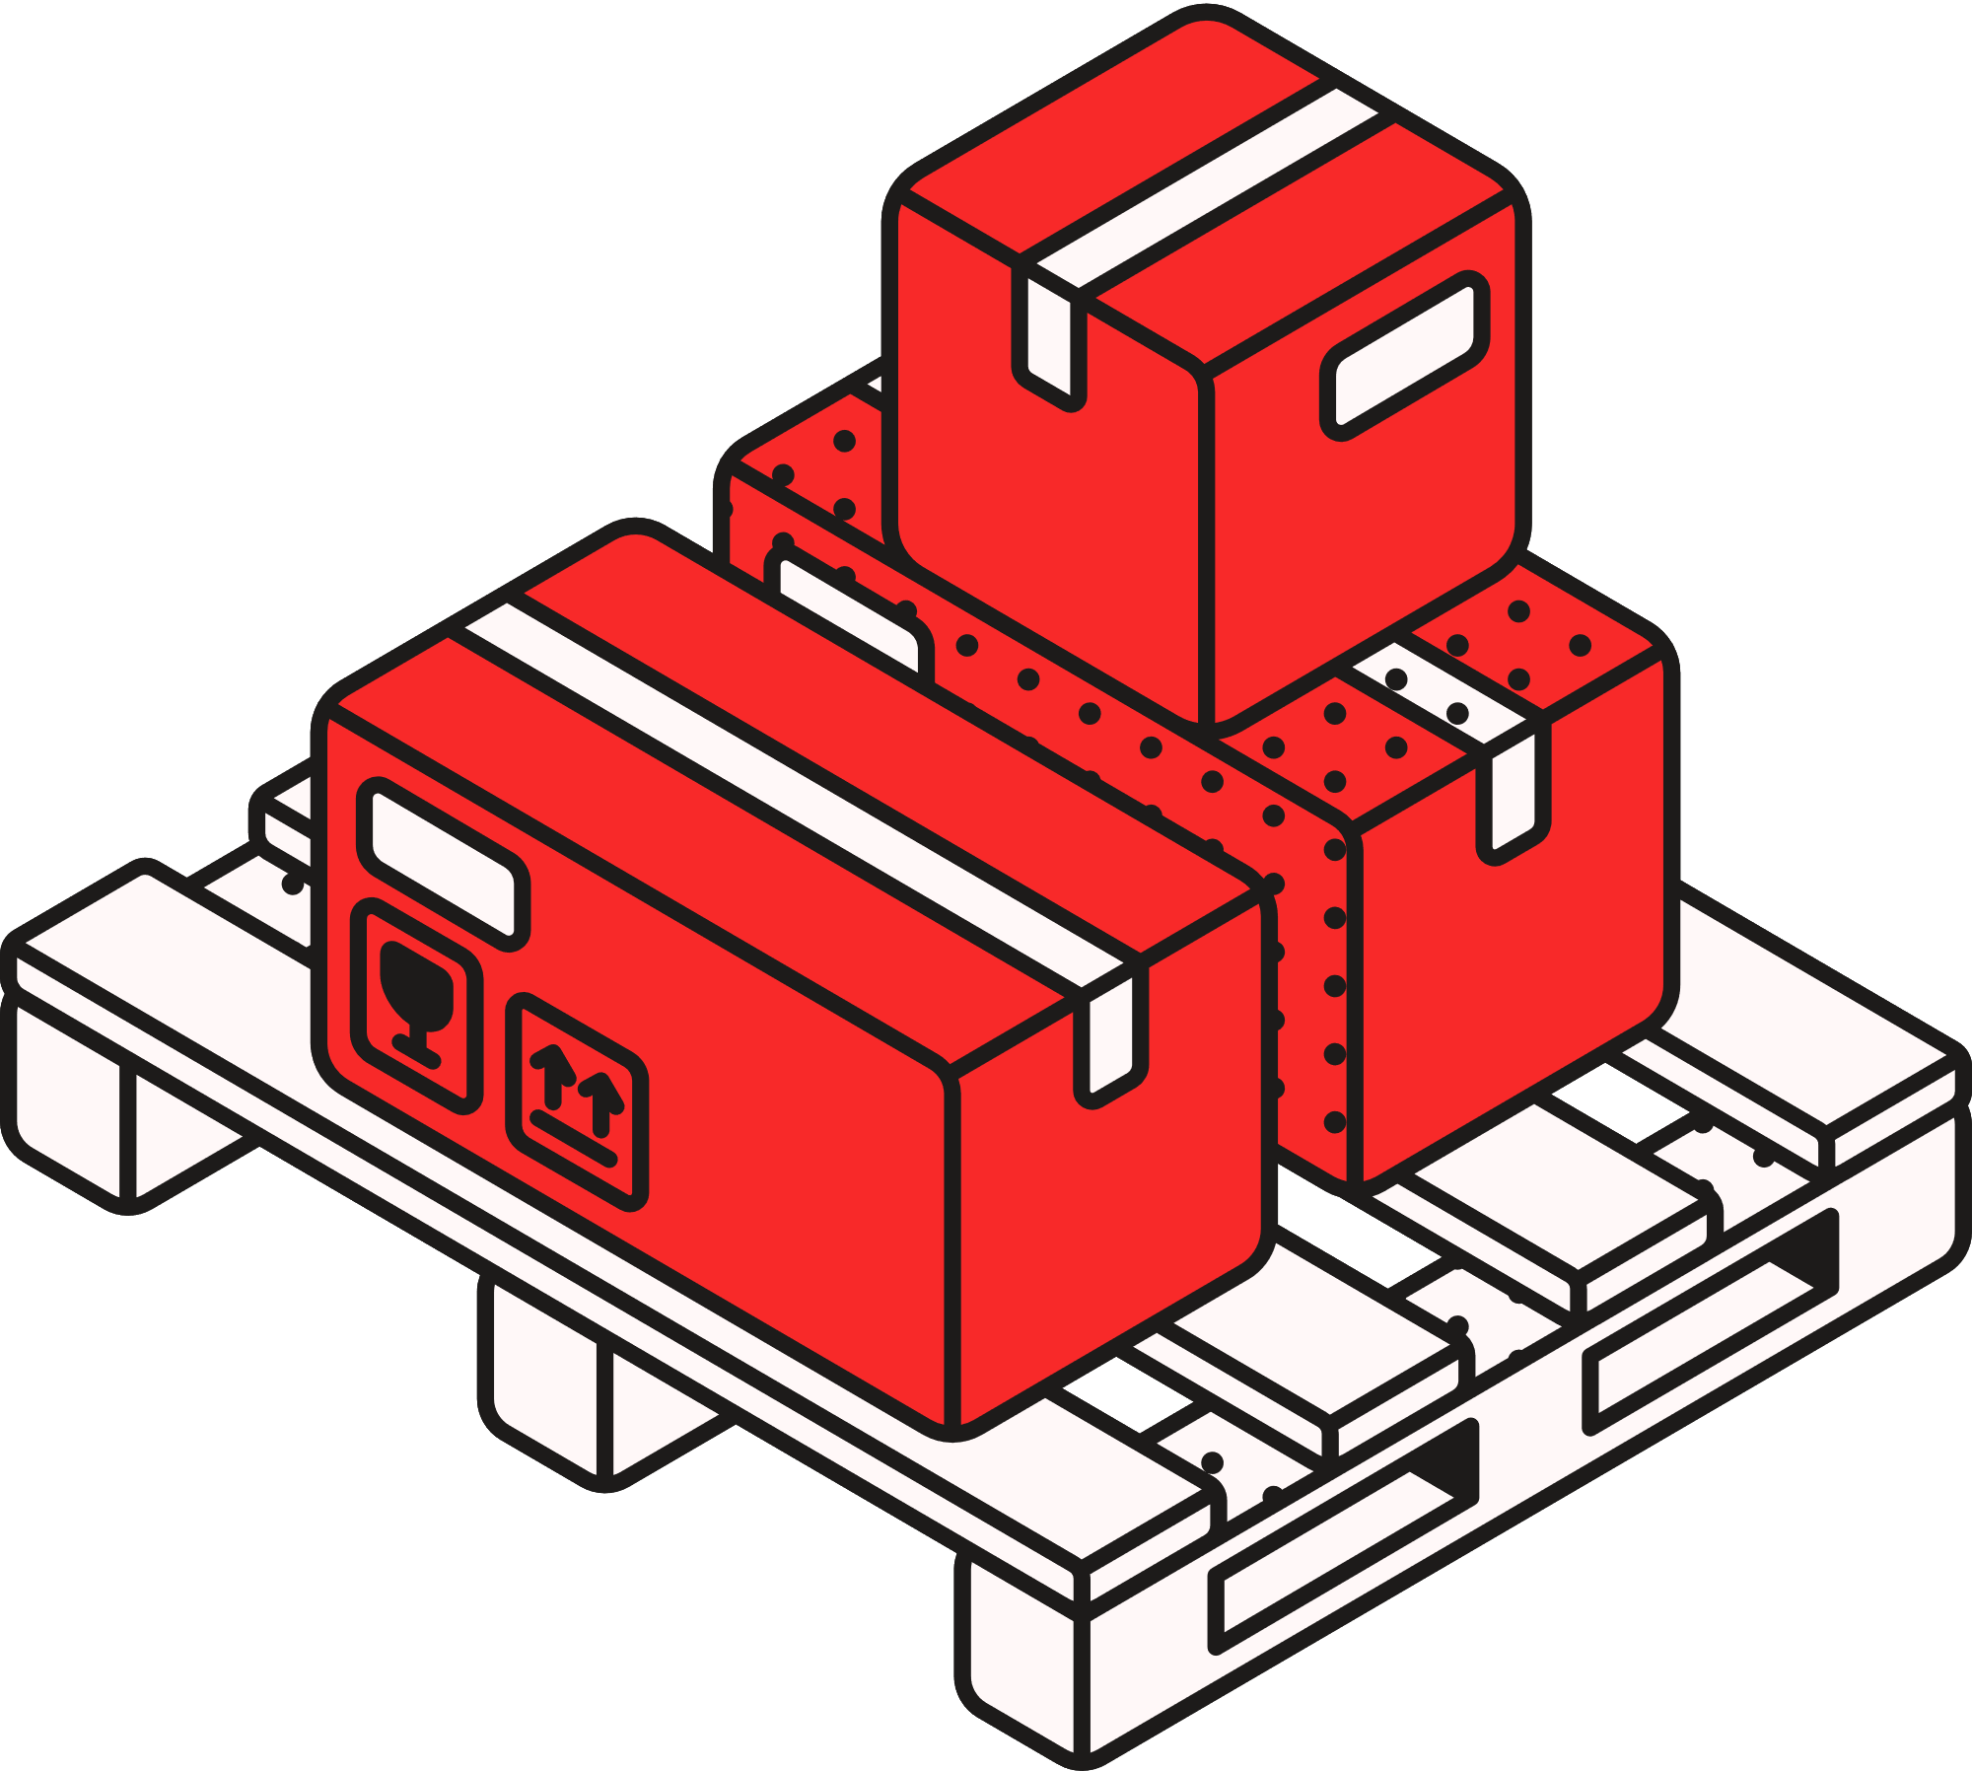
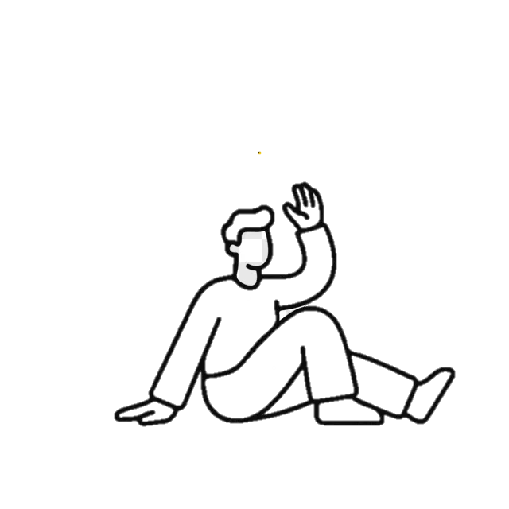

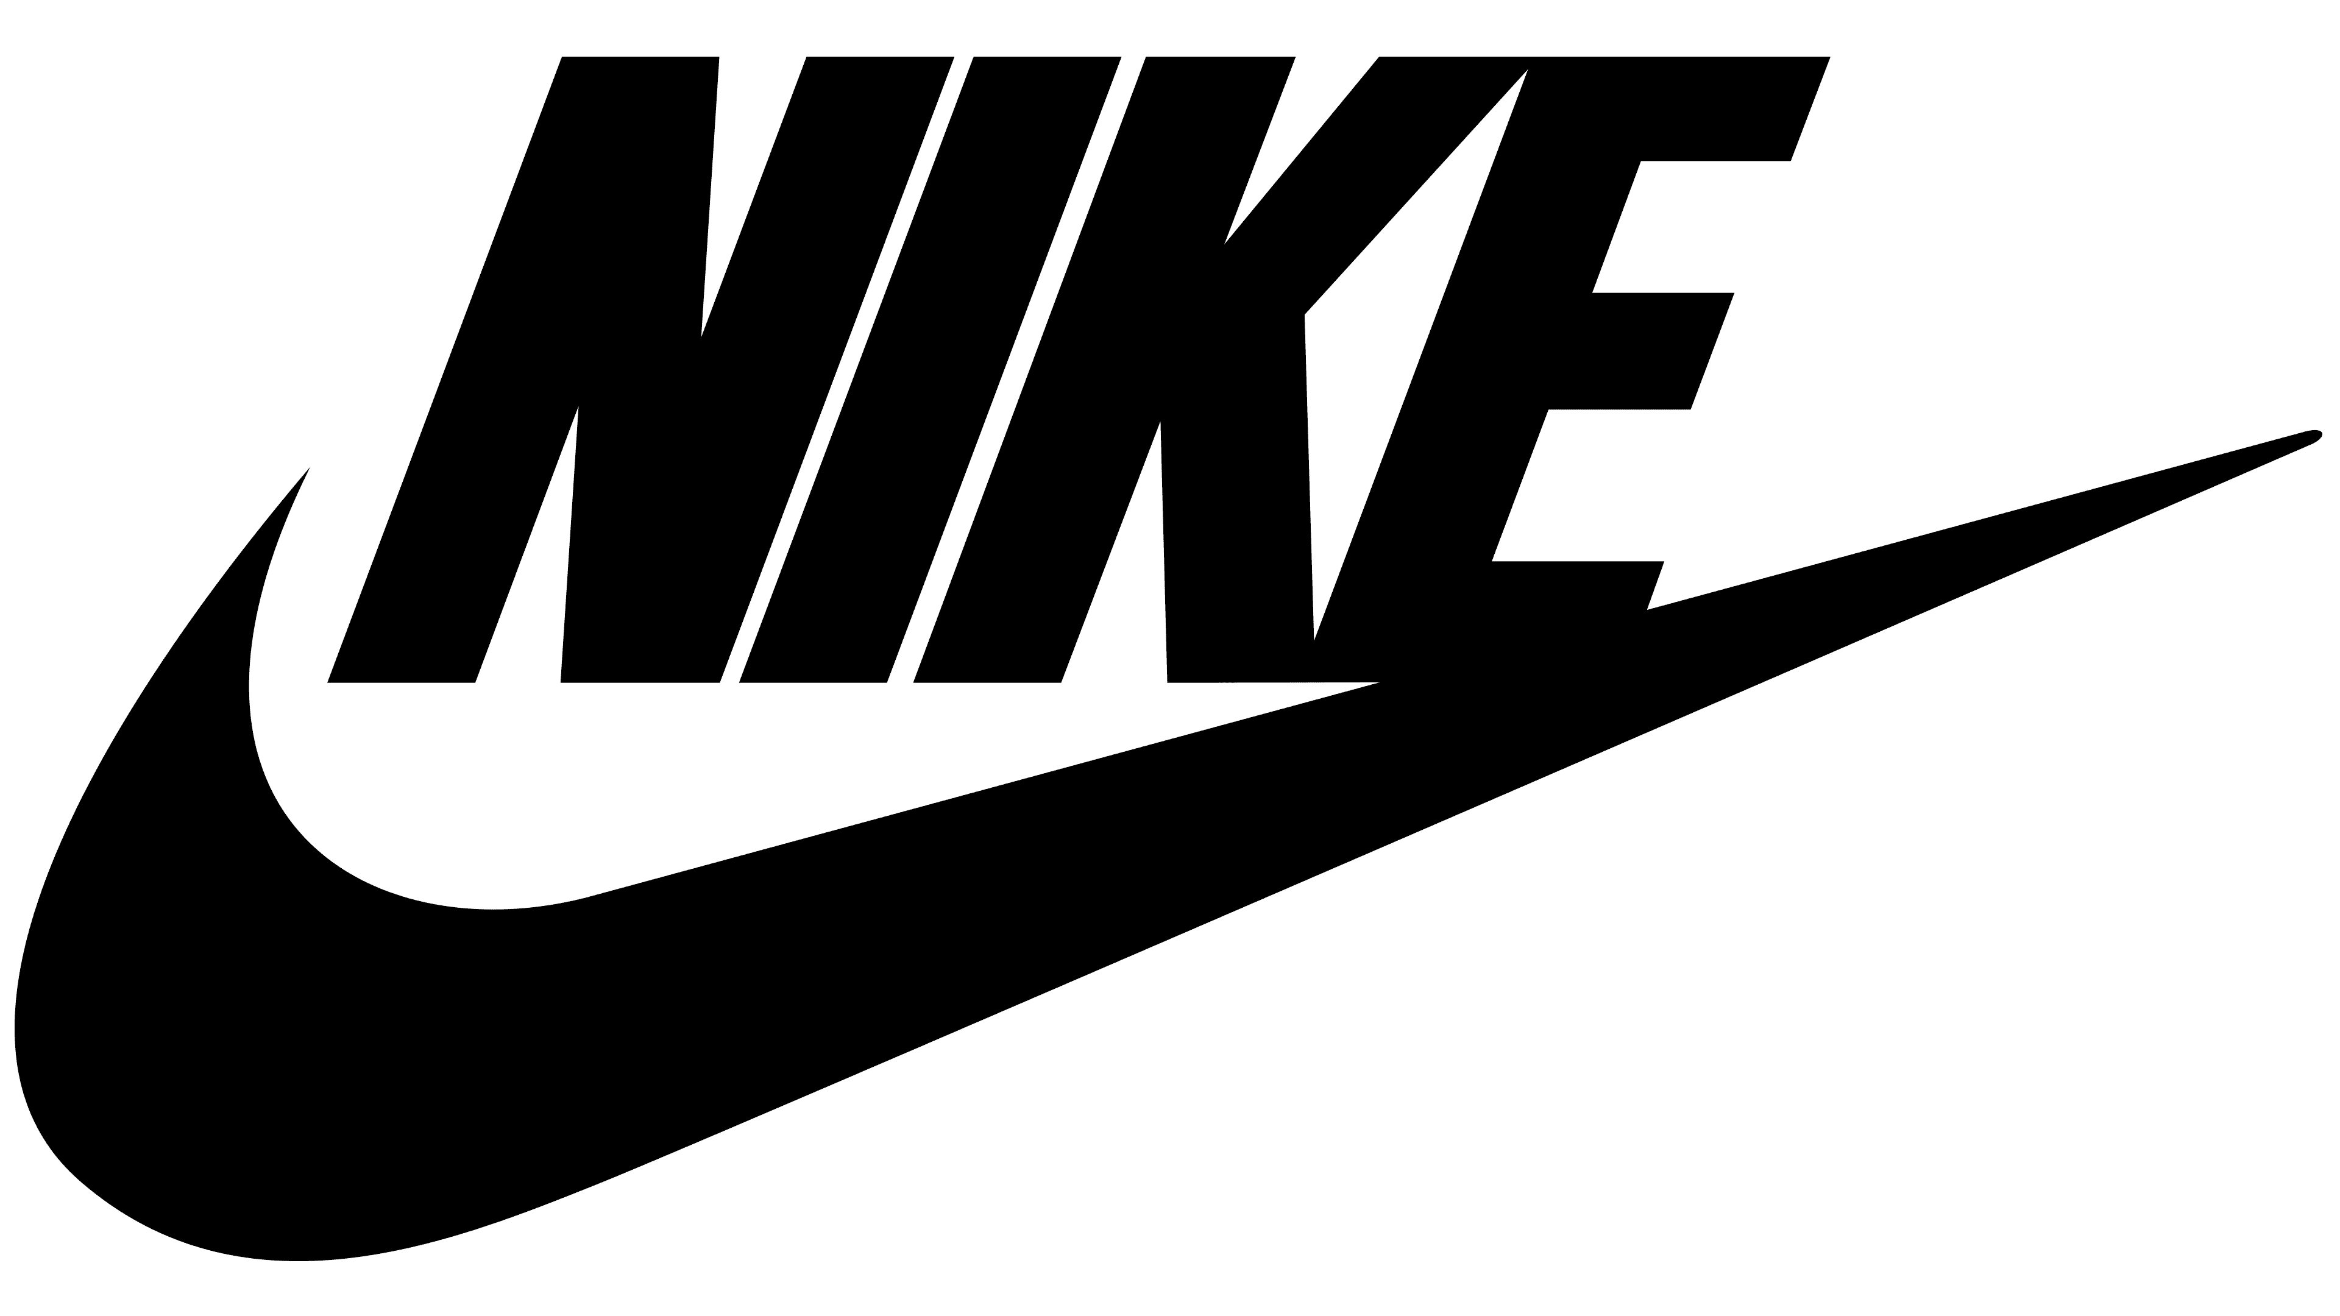

Innovation Strategy Proposal
Just Doing It Differently: An Innovation Strategy Proposal for Nike.
Presented By:
Notes:
Thank you for joining me today for this presentation, as I will be presenting a consultancy-style innovation strategy proposal for the company Nike.

Slide 2

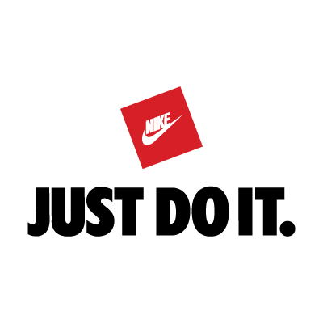
Introduction
  It will first introduce Nike as a leading global sports footwear company and establish its position in the rising and changing market environment.
  The primary new reality that the organisation faces today which is related to the sustainability pressure and the digital transformation, will be analysed.
  The 4 Ps innovation model will be used to assess the present Nike's innovation space matching the proposed strategic recommendations with the implementation roadmap and the final CTA.
Notes:
The goal of this presentation is to provide a thorough analysis of Nike, and to do so, the presentation will introduce Nike and its position in the current market. Before moving to further analysis, the new realities of Nike or the forces of change, the presentation will address both the opportunities and the adaptive challenges that come from the changing landscape. The presentation will later explore Nike's innovation landscape with the help of the 4 Ps model and on that basis. Then, it will formulate a set of recommendations and offer a strategic implementation road map before finishing with a CTA to Nike.

Slide 3
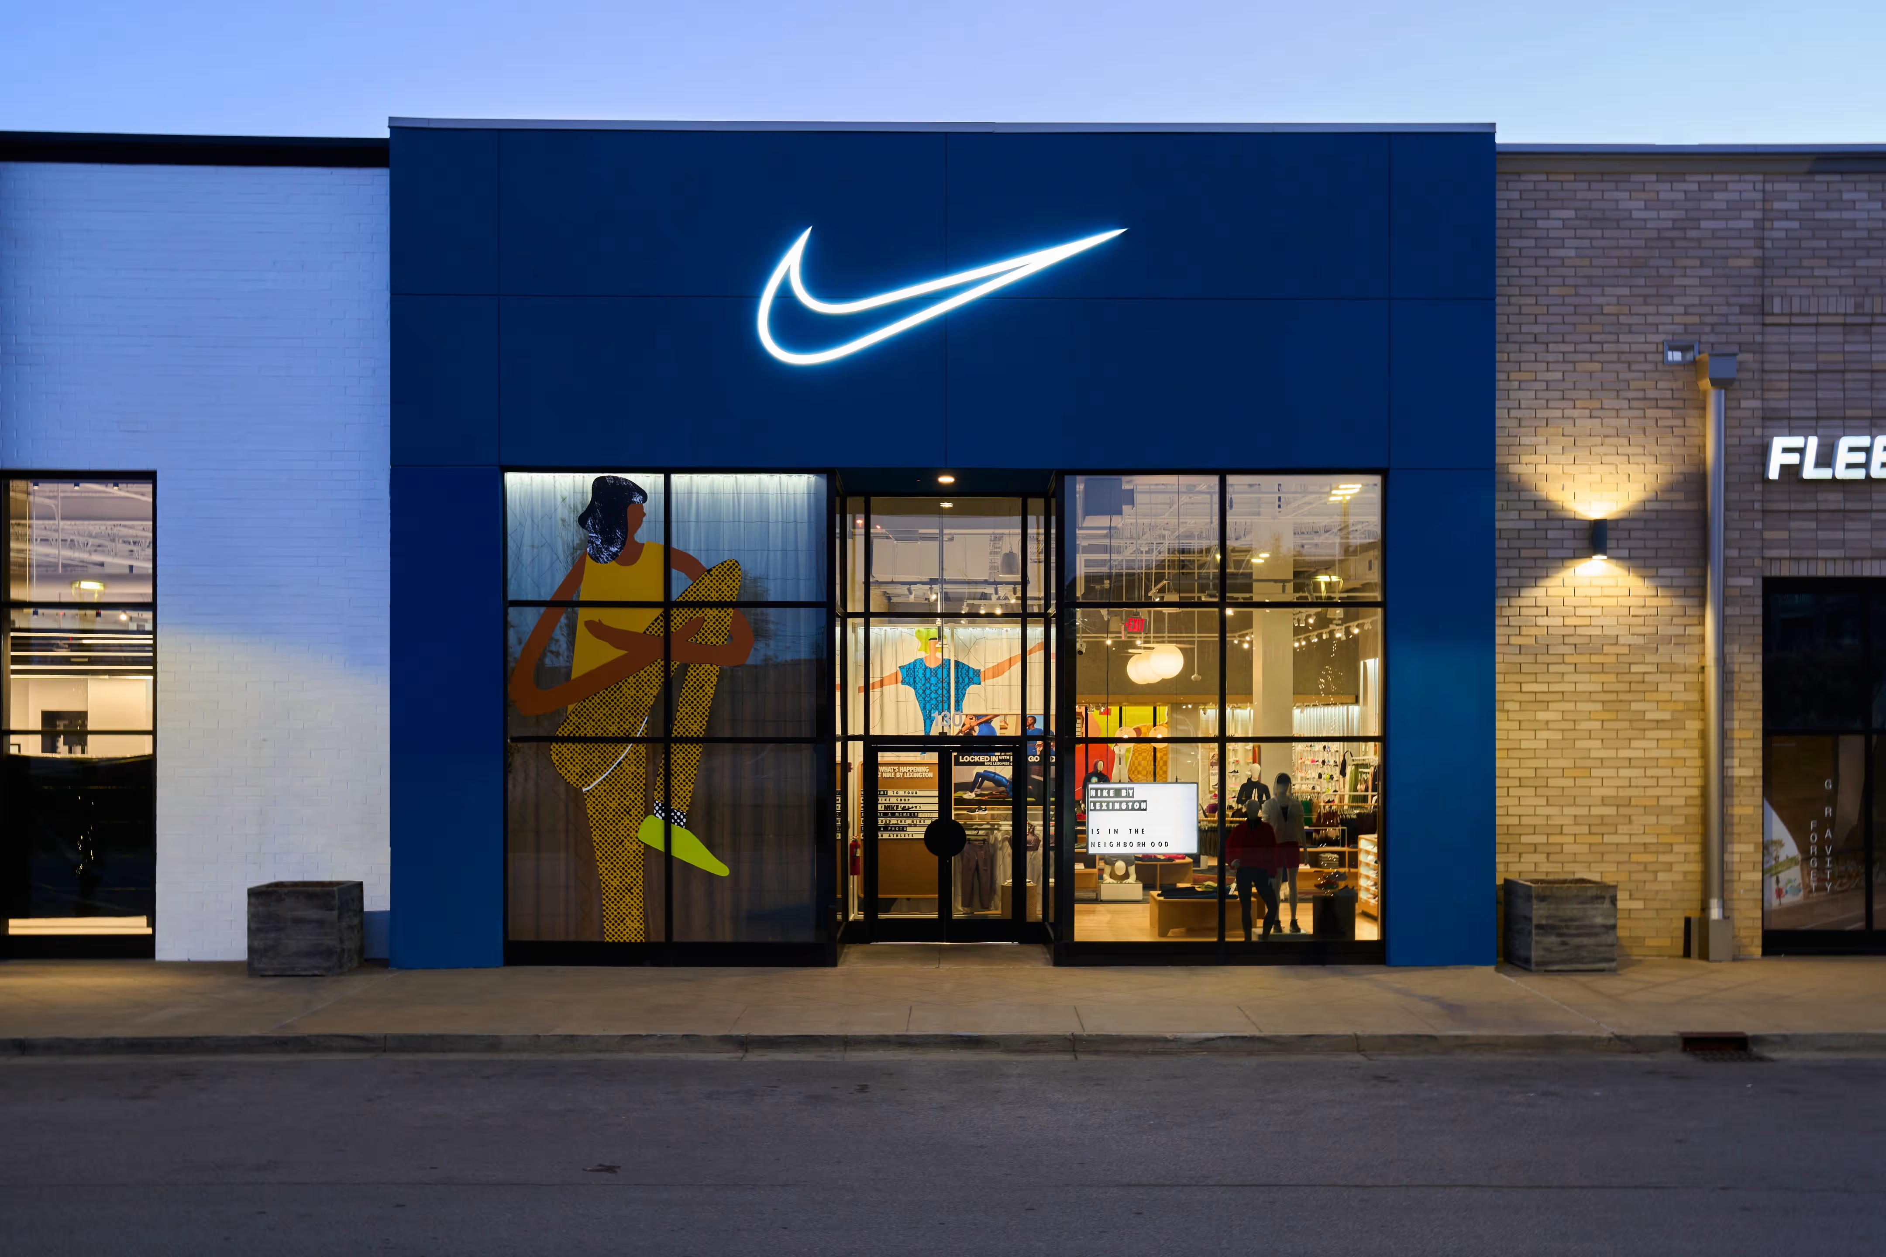
The Case for Innovation
Contact
  The market is volatile and the sportswear market leader Nike has to strive to be a leader by developing premium products and continually modifying its business model (Jha and Fali, 2023).
  Nike experienced problems in its revenues and its position, which led the company to consider possibilities beyond its old competencies and to continue to innovate (Potter, 2025).
  Market-driven forces and the significant value of an active and dynamic innovation strategy need to be included so that Nike can survive and capture new opportunities.
Notes:
The sportswear industry is an extremely volatile market, and in this market, Nike needs to maintain its position as the market leader by creating top-quality products. They continue to adapt and innovate the business model in each of the business operations to stay ahead of the competition in the current dynamic environment. Failure to consider the adaptation can cause the company to face disruption in its revenues or market position. In order to look into the case of Nike, it is important to look beyond the traditional competencies and identify the new sources of innovation beneficial for the company. It is needed to study how these market forces will impact Nike and promote an aggressive and active innovation to thrive in the face of present dangers and future possibilities.

Slide 4
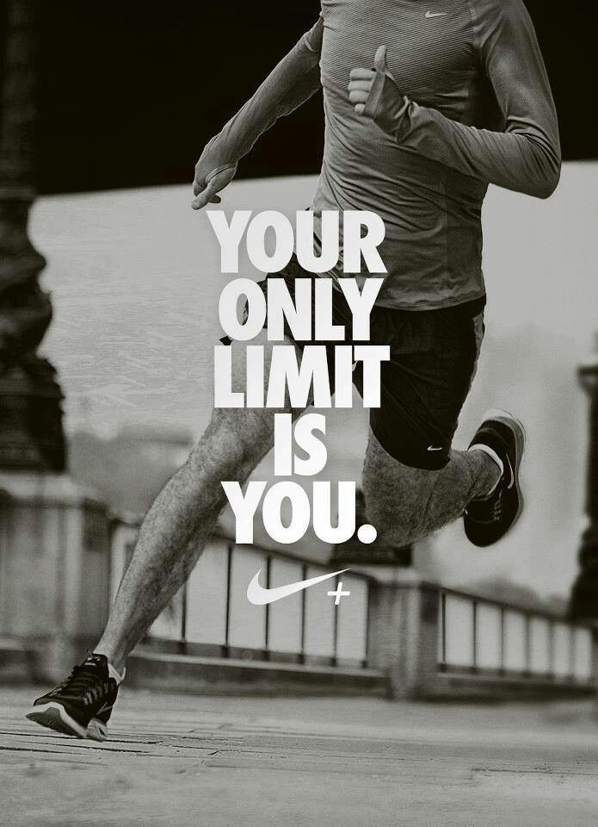
Overview of Nike
Contact
  Nike is the largest seller of athletic shoes and apparel in the world and within their brand portfolio, they have big names like Jordan Brand and Converse (Jha and Fali, 2023).
  Their mission is “To bring inspiration and innovation to every athlete in the world," and the business consistently sets the standard for product innovation with many technologies (Nike, 2026).
  The distribution has shifted from the old model to a digital and more organised D2C strategy for Nike Inc.
Notes:
Established as Blue Ribbon Sports in 1964, Nike is the largest seller of athletic shoes and apparel and contains both the famous Jordan Brand and Converse under its brand portfolio. The mission of the company is "To bring inspiration and innovation to every athlete in the world". They are known for their Air cushioning, Flyknit, React foam and other technology that have consistently been considered as the gold standard of product innovation. With the new Nike business model, they have begun to focus on a direct consumer business, as it appears that the business has changed from an intermediary to a digital-first D2C business.

Slide 5

New Realities The Key Drivers of Change
Sustainability is pushed by the company through 'Move to Zero' as both the consumer preference for sustainable products and regulatory policies are putting pressure on the company (Narayana et al., 2021).
Digital transformation helped Nike to drive new levels of better personalisation and D2C disruption on the Nike App in an entirely new dimension.
Changing consumer and growing need for inclusive, diverse and personalisation demands have posed a major risk to businesses (Nørgaard, 2022).
Geopolitical and economic pressures and trade conflicts between countries and the impacts of inflationary pressures, cause great risks for Nike's operations on a global level (Haas, 2025).
Notes:
Nike has 4 key drivers of change and all of these key drivers are important for the company. These drivers for the company are sustainability, the digital evolution, changing consumer expectations along with political and economic threats. The trend of sustainability is behind the Move to Zero policy, whereas consumer and government pressure are needed for carbon emissions reduction. Digital transformation, data analytics and AI are key to leading hyper-personalisation and DTC disruption like Nike App and evolving consumer expectations are the growth of athleisure and demand for inclusion and personalisation has meant that a major risk for companies is the required changes to positioning. Geopolitical and economic factors also cause significant threats to Nike's supply chain problems and trade wars, all of which are new realities requiring new and flexible approaches.

Slide 6
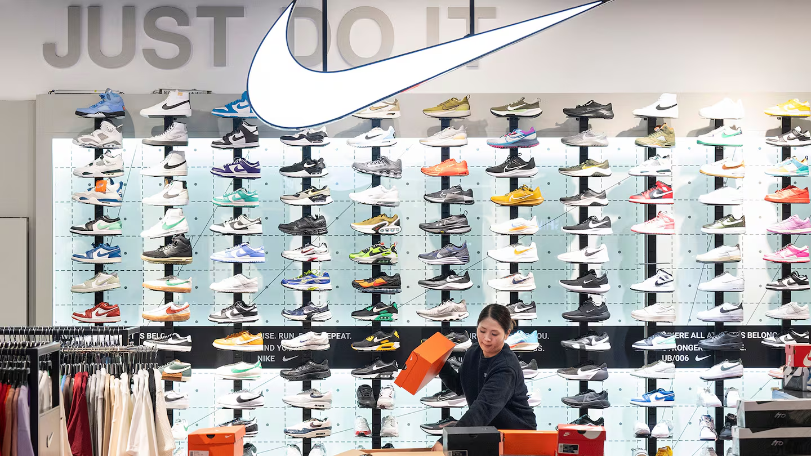
Opportunities and Adaptive Challenges
Contact
  Sustainability allows Nike to lead circular innovation and digital transformation can improve personalisation and build more loyal fans with apps (Kouhihabibi, 2022).
  Sustainability means complete supply chain transparency and ethical sourcing and personalisation means strong data privacy and ethical considerations (Puterisari, 2022).
  Navigating Nike's D2C push can be problematic in balancing the wholesale channel and brand value to consumers like Gen Z.
Notes:
The drivers of change give both opportunities and threats to the company. It begins with the focus on sustainability and a core aspect that can be important in taking Nike to the top of the circular products innovation, along with the digital technology that can help with ultra-customisation and tremendous brand loyalty through the Nike application. The opportunities are linked with significant adaptive issues, as true sustainability cannot happen without immense transparency in the supply chain. To gain sustainability, ethically sourced materials are vital and personalisation, although an opportunity, can also generate serious data privacy and ethical problems. Moving towards D2C for the company, it is important to navigate the issue to create a balance in the relationship with its current wholesale partners and maintain its authentic brand image to the consumer like Gen Z, who are value-driven.

Slide 7
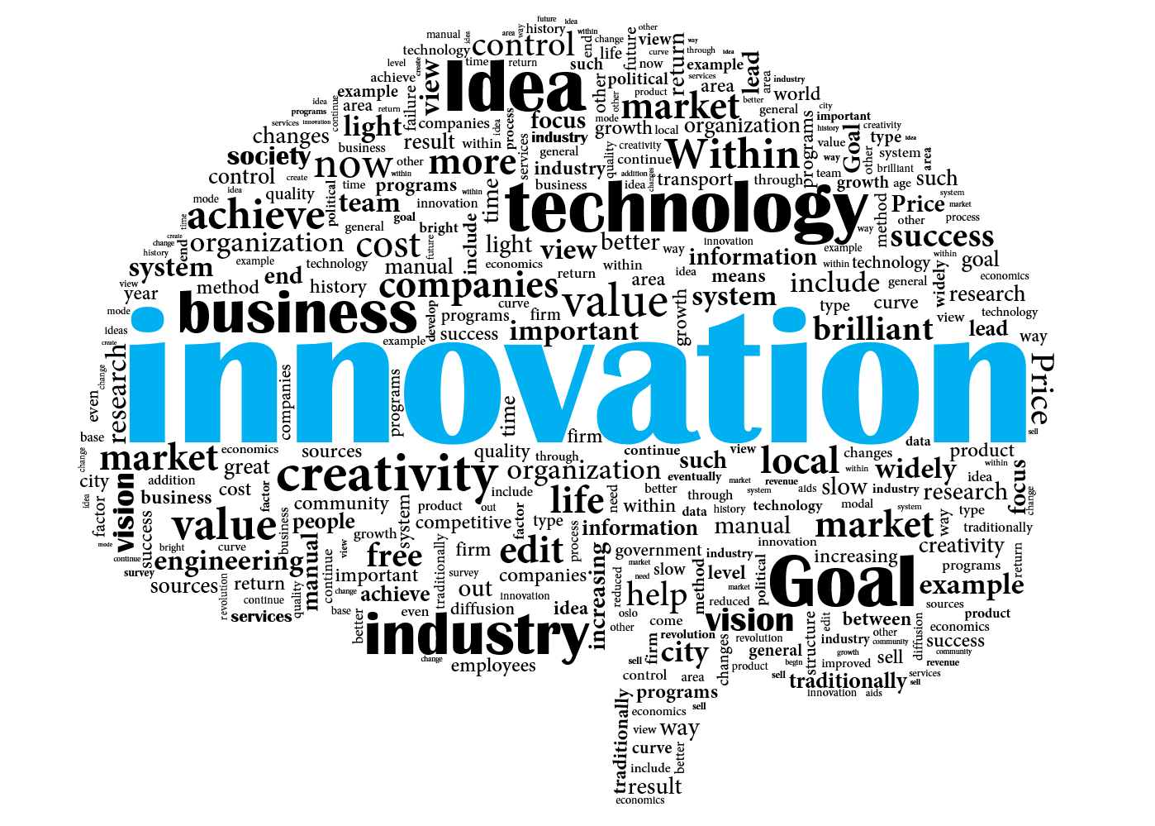
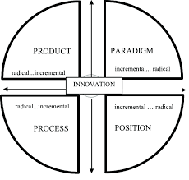
Analysis of Innovation Space Using 4Ps
Contact
  Position innovation can be seen by how they recognise the doubt consumers are experiencing and empathise with their feelings before providing them with inspiration and motivation (Kouhihabibi, 2022).
Nike's product innovation is to develop their self-lacing Adapt BB and their Project Amplify to utilise the power of AI to design better and improve performance aspects (Newcomb, 2019).
  Process innovation is seen in chemical recycling and AI manufacturing techniques where Nike pushed boundaries with these innovations.
Position innovation can be seen by how they recognise the doubt consumers are experiencing and empathise with their feelings before providing them with inspiration and motivation (Kouhihabibi, 2022).
Notes:
The 4Ps are a useful tool that helps to frame the innovation space of Nike as they are innovating within Product, with the latest self-lacing Adapt BB and Powered Footwear System which is named Project Amplify with the use of AI in their design process. They have also started to do chemical recycling as part of their process innovation for their production processes. Nike's change in product innovation shows marketing as position innovation, where they tap into a consumer doubt, address it and then inspire the consumer. There is a big paradigm shift as the transition from a wholesale-oriented company to a digital-first D2C business has completely changed the customer relationship.

Slide 8
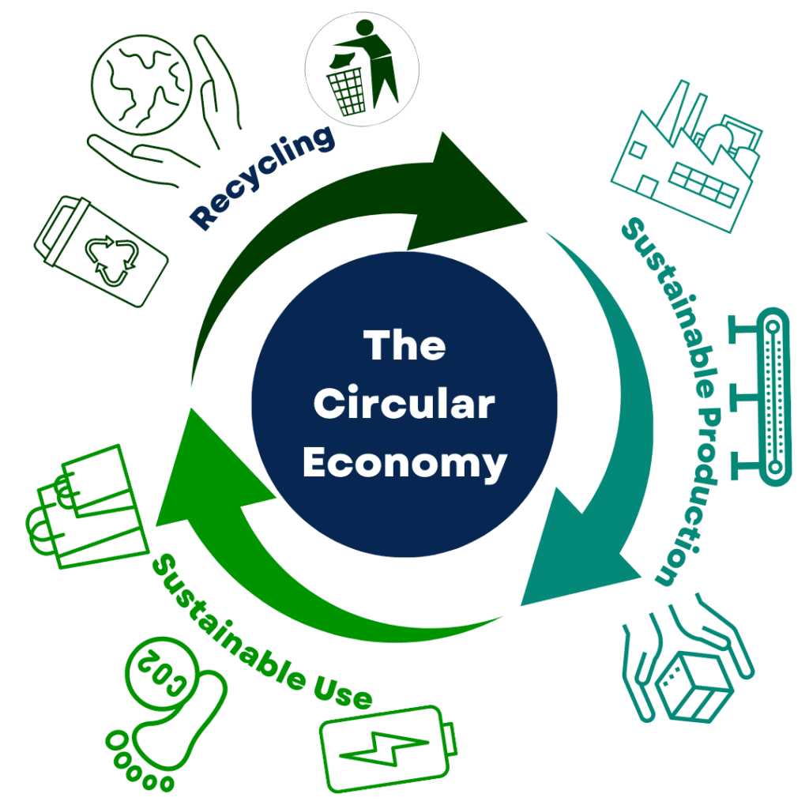
Innovation Recommendations
Circular product innovation and rising take-back programs and recycling rates should be applied to the entire product range.
Nike must utilise personalisation and implement AI in the Nike App for better and more efficient personalised products, training and experiences (Daramola, 2024).
Nike must work with both physical and digital methods that seamlessly narrow down the physical Nike Live retail store and digital platform (Alam, 2021).
Nike must earn trust with a transparent supply chain where they could utilise blockchain technology to verify sustainability claims and responsible sourcing (Sharma, Sharma, and Garga, 2025).
Notes:
There are four recommendations for the company: they should speed up the innovation of their circular product range through scaling of take-back schemes and higher consumption of recycled materials across all Nike products. After that, Nike should lead service personalisation, through integrating AI within the Nike App so all their products, training sessions and experiences are ultra-personal. Nike should create and develop both physical and digital customer experiences, linking Nike Live stores and the digital universe. Nike should develop trust through sustainability, supply chain resilience and ethics with a new blockchain platform in order to show the sustainability within supply chain traceability. These methods should help Nike to win over the current challenges and benefit from the opportunity to implement all their innovation goals.

Slide 9
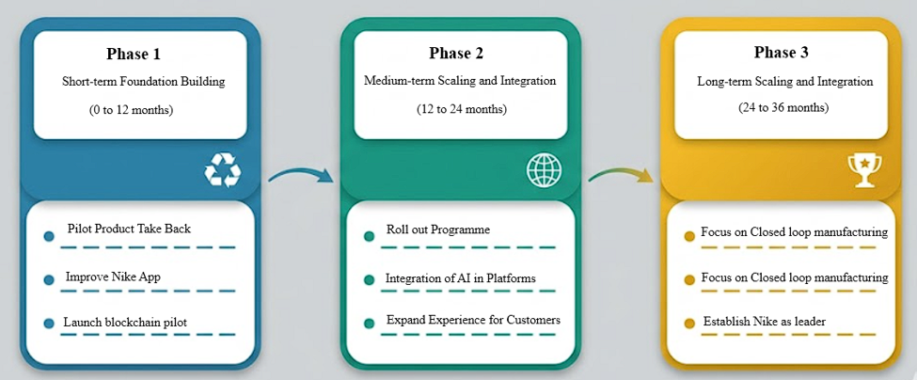
Proposed Innovation Framework: Implementation Roadmap
In the short term, the company should implement pilot take-back programmes that would focus on markets and create simple AI capabilities for the apps.
Nike to implement initiatives globally that are more circular in their approach in both their physical and digital location for all the stores within the medium-term.
The long-term goals for the company are fully closed-loop manufacturing and blockchain tracing for full supply chain transparency.
Notes:
The recommendations needed to be rolled out in structured and different phases. In the short term which will be for one year, the first steps Nike needs to take are to have a take-back scheme in operation within priority markets and to develop fundamental AI features within Nike Apps. The medium term will be of two years, where the launch and embedding of circular programmes on an international scale will be achieved, and the design of both physical and digital elements in every store. The long term will be for 3+ years and leadership and transformation should be the focus in the long term. The roadmap provides logical, implementable and clear stages in order to achieve Nike's strategy of innovation and maintain a sustainable competitive advantage.

Slide 10

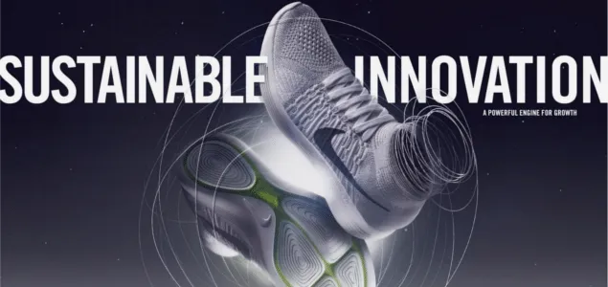

Conclusion
  Integrating product, process, position and paradigm innovation will help the company to turn the identified threats here into formidable growth opportunities.
  Digital disruption, sustainability and evolving consumer habits are concerning for the company as they need to change their focus to keep the innovation alive.
  Nike needs to increase their expenditure in areas of sustainable design, smart personalisation, and seamlessly integrated experience.
Notes:
The company need to reconsider how it will develop innovation and also to adapt to new strategies and to move from a 'Just Do It' philosophy towards a 'Just Innovate' philosophy due to factors of digital disruption, sustainability and changing consumer behaviour. They need to integrate products, processes, positions, and paradigms as they can make the difficulties facing them into vast opportunities. The investment should increase on the design side and the personalisation of the consumer's experience through AI and the holistic consumer experience. It will help them to continue leading the game in the athletic industry, and continue their motivation of 'Just Do It' and motivate future athletes for years to come.

Slide 11
Reference List
Alam, M.S., 2021. Circular Economy: Consumer Perception for Remanufactured Goods.
Daramola, O., 2024. Building a Circular Supply Chain: Why It is Important to the United States Economy. Available at SSRN 4891229.
Haas, J.D., 2025. Beyond the Price Tag: Unveiling the Hidden Impacts of Tariffs on Businesses and Consumer Behavior.
Jha, S. and Fali, I.M., 2023. Retail Performance and Competitive Positioning of Nike and Adidas in Australia in the Period (2016-2017): A Comparative Statistical and Strategic Analysis. Qubahan EcoLead Journal, 2(4).
Kouhihabibi, M., 2022. Linear economy versus circular economy: New raw material. Journal of Management and Economic Studies, 4(3), pp.227-246.
Narayana, A., Oyama, N., Gough, R. and Calhoun, B., 2021. Nike Inc.: Strategic Communication Plan. Strategies, 8(9).
Newcomb, T., 2019. Nike debuts Self-Fitting Smart-Sneaker technology as business model of future. https://www.forbes.com/sites/timnewcomb/2019/01/15/nike-debuts-self-fitting-smart-sneaker-technology-as-business-model-of-future/ (Accessed: June 17, 2026).
Nike, 2026. What is Nike’s mission? | Nike Help. https://www.nike.com/help/a/nikeinc-mission (Accessed: June 17, 2026).
Nørgaard, N., 2022. Environmental sustainability and social (in) justice in Nike’s Space Hippie campaign video–a multimodal approach. RASK-International journal of language and communication, (55), pp.75-94.
Potter, L., 2025. Tackling climate change in sport: Nike’s sustainable impact. https://sustainabilitymag.com/news/tackling-climate-change-in-sport-nikes-sustainable-impact (Accessed: June 17, 2026).
Puterisari, D.U., 2022. Strategic management in Industry 4.0: digital transformation in NIKE Inc. Using the dynamic capability approach. International Journal of Business, Humanities, Education and Social Sciences (IJBHES), 4(2), pp.103-108.
Sharma, A., Sharma, T. and Garga, P., 2025, November. From Waste to Worth: A Case Study Analysis of Circular Economy Practices in Leading Global Companies. In 2nd International Conference on Sustainable Business Practices and Innovative Models (ICSBPIM-2025) (pp. 841-853). Atlantis Press.

Slide 12

