Slide 1


Strategic Analysis of Global Strategy, Innovation and Operations for Walmart Inc.
Student Name:
Student Number:

Slide 2

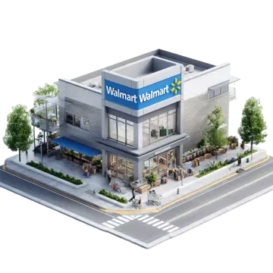
Introduction
Walmart: World’s dominant multinational retail corporation.
Operates 10,500+ stores across 19 countries globally (Walmart, 2025).
Core sectors: Grocery, general merchandise, and e-commerce.
Analysis covers external, innovation, and global strategy.
Notes:
Walmart Inc.'s dominance in the retail market is unparalleled, with revenues exceeding $648 billion in fiscal 2024. The company has an extensive network of supercentres, Sam's Clubs, and a growing e-commerce platform. This presentation will analyse the macro and competitive factors that affect Walmart's strategy, evaluate how well Walmart's innovation creates competitive advantages, and examine how its transnational approach combines Walmart's vast operations across the globe. It will include actionable insights and recommendations for the future.

Slide 3


External Environment Analysis
PEST Analysis
01
03
Economic: Persistent inflationary pressures affecting cost-conscious consumers (Brown and Tabassum, 2026).
Political: Navigating complex trade policies and geopolitical tensions.
02
04
Social: Surging demand for value and seamless omnichannel experiences (Buchdadi, 2024).
Technological: AI-powered supply chain and cashier-less store innovations.
Notes:
Based on PEST analysis, the macro environment around Walmart has many complexities. Politically, the ongoing trade tensions between the United States and China are constantly threatening Walmart's cost-efficient supply chain. Economically, Statista data shows that inflation in the United States reached its highest level in 2022, reinforcing Walmart's price leadership but compressing bottom line margins. Socially, the continued transition to hybrid shopping confirms the heavy investment Walmart has made in curb side pickup and delivery. Technologically, Walmart's annual report for 2024 mentions the use of AI for inventory management, which makes its enormous data lake a fundamental strategic asset that can create efficiency.

Slide 4
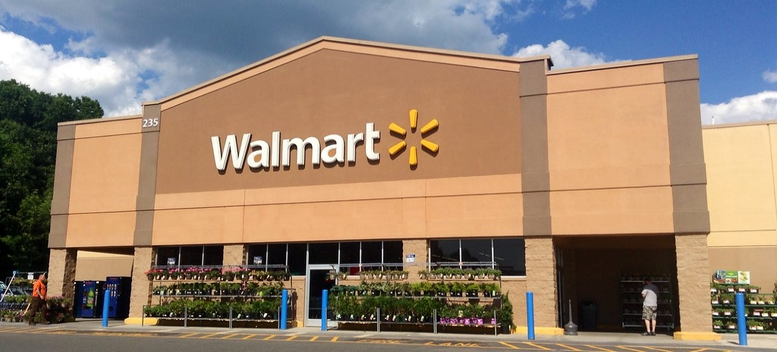
Porter’s Five Forces Analysis
Competitive Rivalry: Intensely high from Amazon, Costco, and discounters (Nassauer, 2025).
Buyer Power: Extremely high due to low switching costs online.
Supplier Power: Low; Walmart’s massive scale dictates terms effectively.
Threat of Entry: Low, capital-intensive market with scale barriers.
Notes:
Porter’s five forces analysis suggests that competition in the market is intense, with Amazon’s e-commerce strength along with Costco’s membership model creating constant pressure. A recent McKinsey report cites Walmart’s expanding vendor base as a response to supplier bargaining power; however, Walmart continues to benefit from its size, which makes it an extremely powerful negotiating partner. There is a high threat of substitution from niche e-commerce-based retailers in the online landscape. Ultimately, Walmart’s fundamental business strategy is an ongoing reaction to high consumer buying power by providing everyday low prices (EDLP) to build consumer loyalty in an increasingly competitive marketplace.

Slide 5

Innovation Strategy Assessment
Pillars of Innovation
Omnichannel integration: Blending physical stores with digital fulfilment (Walmart, 2025b).
Supply chain automation: Robotics and machine learning in distribution.
Sustainability focus: Project Gigaton and zero-emission logistics.
Data monetization: Walmart Connect retail media network expansion.
Notes:
Walmart's innovation strategy is more than technology-driven; it requires changing its entire business model. The company is also using its 4,600+ physical locations as fulfilment centres to make omnichannel retail financially feasible. The 2023 annual report highlighted automated distribution centres as an answer to labour shortages. Innovative efforts are also shifting to high-margin service areas such as Walmart Connect, its advertising platform, which saw growth exceeding 30% in fiscal 2024, illustrating that data-driven innovation is directly reshaping revenue streams.

Slide 6

Innovation and Competitiveness
Competitiveness: Enables price parity and unrivalled delivery convenience.
International adaptation: PhonePe in India and Flipkart’s Big Billion Days (Siddharth Cavale, 2023).
Strategic decision: Shifting from international capex to tech acquisitions.
Critique: Innovation is largely follower-based, lacking first-mover disruption.
Notes:
Walmart's international competitive advantage would not be strong without innovation. However, only when taking a closer look can we see that it has a followers' strategy. In India, acquiring Flipkart and PhonePe allowed Walmart to quickly adopt the changes needed to fit the mobile first marketplace, spurring on digital payments available through their ecosystem. A 2024 peer-reviewed journal could argue that Walmart's main competitive advantage is based on cost leadership and not new innovations. Its strategic decision to acquire rather than develop innovative capabilities highlights the dilemma of needing to have fast, but at the same time building up an overall culture of disruptive innovation globally

Slide 7

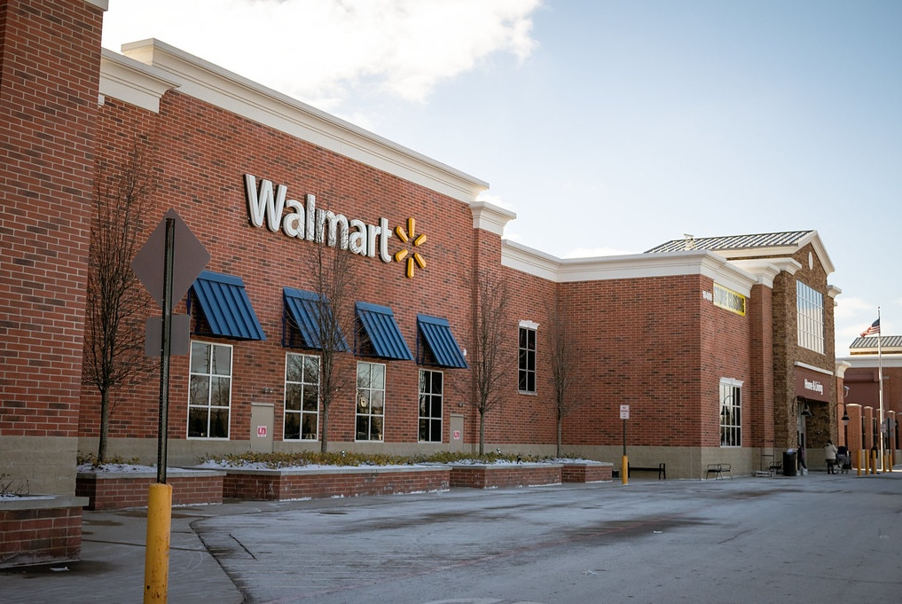
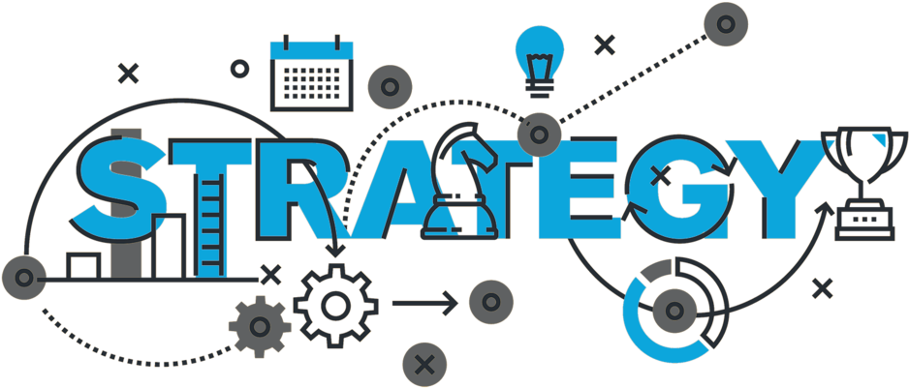
Global Strategy Evaluation
Core approach: A sophisticated transnational strategy globally.
Balances cost-efficiency (global) with local market responsiveness (Walmart, 2025a).
Exceptions: Home-replication failures in Germany and South Korea (Rumapea and Gerarldo, 2024).
Multi-domestic elements in India and Mexico for local brand equity.
Notes:
When regrouping as per the typology of strategies, Walmart has a largely transnational strategy; it benefits from its global supply chain by lowering costs, but at the same time modifies their stores and products to be as local as possible. The 2024 annual report also talks about the smaller format stores opened by Walmart in Mexico. Its entry into India, however, was not successful due to challenges with local regulations and required a multi-domestic strategy via the acquisition of Flipkart and creating local partnerships. Walmart learned from its original mistakes in Germany, a classic case of "home replication," that in order to achieve sustainable international success it has to be locally responsive to each region.

Slide 8

Strategic Alignment
Industry alignment: Grocery requires local sourcing, fitting multi-domestic needs.
Competitive alignment: Global scale battles Amazon’s cost structure (Jindal, 2021).
Resource alignment: Proprietary supply chain tech is globally standardised.
Global framework: Integrates global data analytics for local execution.
Notes:
The grocery industry's perishable nature necessitates local supply chains, which are supported by Walmart's global best practice framework of managing an efficient and compliant supply chain that allows for local execution. Its competitive war with Amazon is a global logistics war, and Walmart's proprietary retail systems and automated distribution centres are global resources that provide the standardised backbone of the retailer's business for executing in local markets and thus provide Walmart with a coherent, albeit complex, corporate capability strategy.

Slide 9

Recommendations & Challenges
Recommendations
Accelerate AI-driven hyper-personalisation across the Walmart+ membership (Walmart, 2024).
Expand B2B services, leveraging logistics for third-party marketplace sellers.
Deepen emerging market health services, integrating diagnostics and telehealth.
Pioneer a circular economy model to monetize product resale and recycling.
Notes:
The first recommendation is for Walmart to leverage its data with generative AI for hyper-personalised shopping and provide its Walmart+ members with predictive convenience that goes beyond just price. Second, Walmart should aggressively grow its Walmart Fulfilment Services, therefore competing against Amazon by opening its world-class logistics network up as a service to merchants. Third, in high-growth markets such as India, Walmart can incorporate affordable telehealth and diagnosis services into their retail ecosystem. Finally, a circular economy platform would create a profitable resale and recycling platform to meet the sustainability requirements of Gen Z consumers.

Slide 10

Implementation Challenges
Internal: Siloed legacy systems impeding enterprise-wide AI integration.
Internal: Workforce reskilling for 2.1 million employees at scale.
External: Stringent EU data privacy regulations (GDPR) restricting personalisation (Desk, 2026).
External: Cultural resistance in cash-based economies to digital ecosystems.
Notes:
The challenges facing Walmart's implementation of its recommendations are both internal and external. Internally, the technical complexity and costs associated with integrating advanced AI with Walmart's legacy IT systems will pose a challenge. The company's 2.1 million employees will require significant reskilling in order to transition to an AI-enhanced services-oriented culture, which will be a monumental organisational challenge. Externally, the clash of Walmart's hyper-personalisation strategy for expansion into European markets with strict GDPR guidelines creates significant risks for fines. Additionally, creating a telehealth ecosystem within a cash-based, culturally-diverse country such as India presents significant cultural and logistical challenges and will require a significant level of effort from multiple stakeholders.

Slide 11
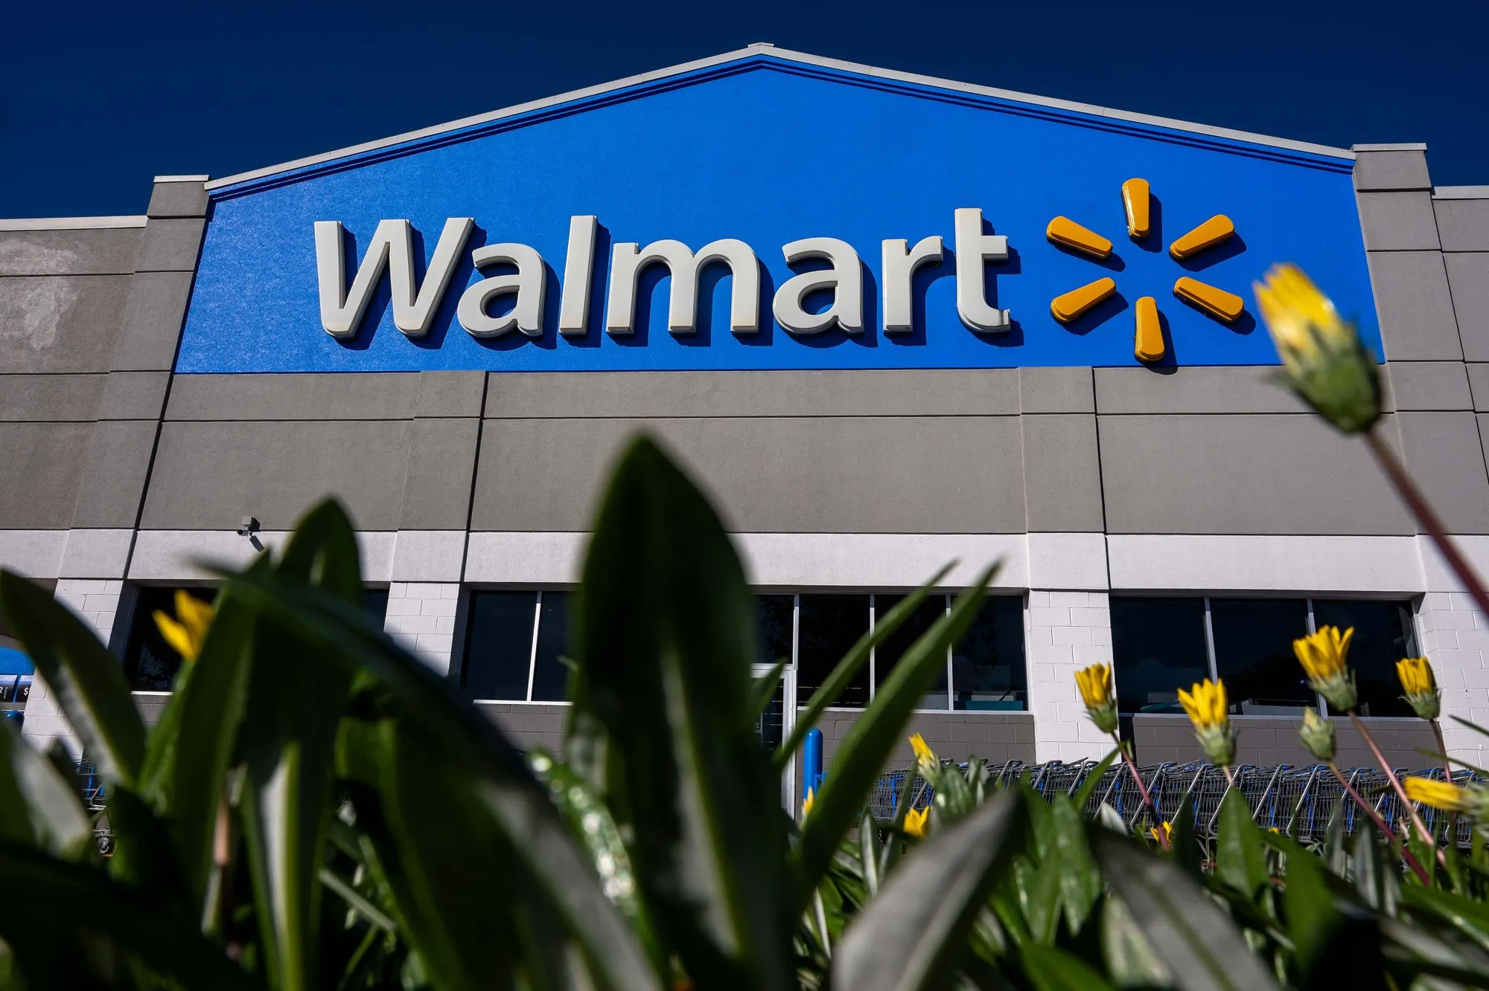

Conclusion
Core approach: A sophisticated transnational strategy globally.
Balances cost-efficiency (global) with local market responsiveness (Walmart, 2025a).
Exceptions: Home-replication failures in Germany and South Korea (Rumapea and Gerarldo, 2024).
Multi-domestic elements in India and Mexico for local brand equity.
Notes:
When regrouping as per the typology of strategies, Walmart has a largely transnational strategy; it benefits from its global supply chain by lowering costs, but at the same time modifies their stores and products to be as local as possible. The 2024 annual report also talks about the smaller format stores opened by Walmart in Mexico. Its entry into India, however, was not successful due to challenges with local regulations and required a multi-domestic strategy via the acquisition of Flipkart and creating local partnerships. Walmart learned from its original mistakes in Germany, a classic case of "home replication," that in order to achieve sustainable international success it has to be locally responsive to each region.

Slide 12
References
Brown, N. and Tabassum, J. (2026) Scale, online push and loyalty fees: how Walmart won the year of the tariffs, Reuters. Available at: https://www.reuters.com/business/retail-consumer/scale-online-push-loyalty-fees-how-walmart-won-year-tariffs-2026-05-19/ (Accessed: 11 June 2026).
Buchdadi, A.D., (2024). Segmenting walmart customers for personalized marketing strategies using MiniBatchKMeans clustering and decision trees: an analysis of purchasing behavior. Journal of Digital Market and Digital Currency, 1(3), pp.204-224. https://jdmdc.com/index.php/JDMDC/article/view/18
Desk, T.T. (2026) ‘America’s largest private employer tells its employees AI will not take their job’, The Times of India. The Times Of India. Available at: https://timesofindia.indiatimes.com/technology/tech-news/americas-largest-private-sector-employer-walmart-has-a-message-for-its-2-million-plus-employees-on-ai-replacing-their-jobs-technology-will-power-our-/articleshow/131585706.cms (Accessed: 11 June 2026).
Jindal, R.P. (2021) ‘Omnichannel battle between Amazon and Walmart: Is the focus on delivery the best strategy?’, Journal of Business Research, 122(1), pp. 270–280. Available at: https://doi.org/10.1016/j.jbusres.2020.08.053.
Nassauer, S. (2025) How Walmart Built the Biggest Threat Amazon Has Faced, WSJ. The Wall Street Journal. Available at: https://www.wsj.com/business/retail/walmart-ecommerce-amazon-competitor-b7fe1cd5 (Accessed: 11 June 2026).
Rumapea, T. and Gerarldo, A., 2024. Strategic approaches to international market penetration for local products. Journal on Economics, Management and Business Technology, 2(2), pp.102-111. https://doi.org/10.35335/jembut.v2i2.211
Siddharth Cavale (2023) ‘Flipkart and PhonePe could be $100 billion businesses in India, Walmart says’, Reuters, 14 June. Available at: https://www.reuters.com/technology/flipkart-phonepe-could-be-100-billion-businesses-india-walmart-says-2023-06-14/ (Accessed: 11 June 2026).
Walmart (2024) Walmart Reveals Plan for Scaling Artificial Intelligence, Generative AI, Augmented Reality and Immersive Commerce Experiences, Walmart.com. Available at: https://corporate.walmart.com/news/2024/10/09/walmart-reveals-plan-for-scaling-artificial-intelligence-generative-ai-augmented-reality-and-immersive-commerce-experiences (Accessed: 11 June 2026).
Walmart (2025a) Location facts, Walmart. Available at: https://corporate.walmart.com/about/location-facts (Accessed: 11 June 2026).
Walmart (2025b) Walmart’s U.S. Supply Chain Playbook Goes Global — and It’s Reinventing Retail at Scale, Walmart.com. Available at: https://corporate.walmart.com/news/2025/07/17/walmarts-us-supply-chain-playbook-goes-global-and-its-reinventing-retail-at-scale (Accessed: 11 June 2026).

Slide 13

Thank You

